Slide 1
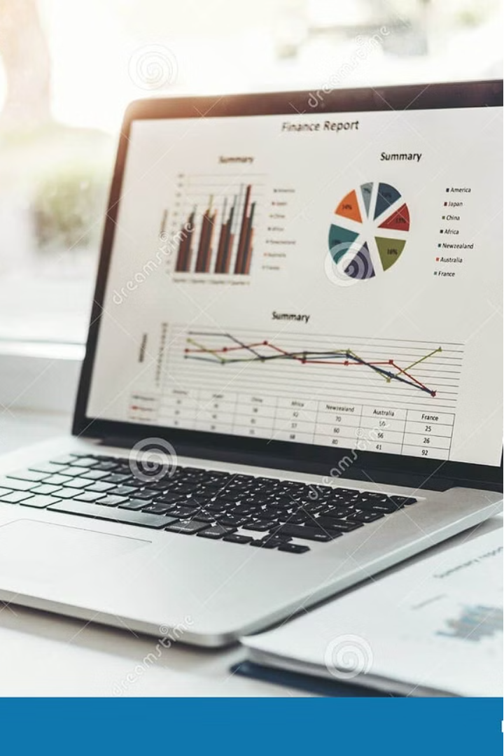

Automated Sales Report Generator
This project streamlines the monthly sales reporting process by leveraging powerful Python tools to analyze data, generate visualizations, and compile comprehensive PDF reports - all through a user-friendly command-line interface.

Slide 2
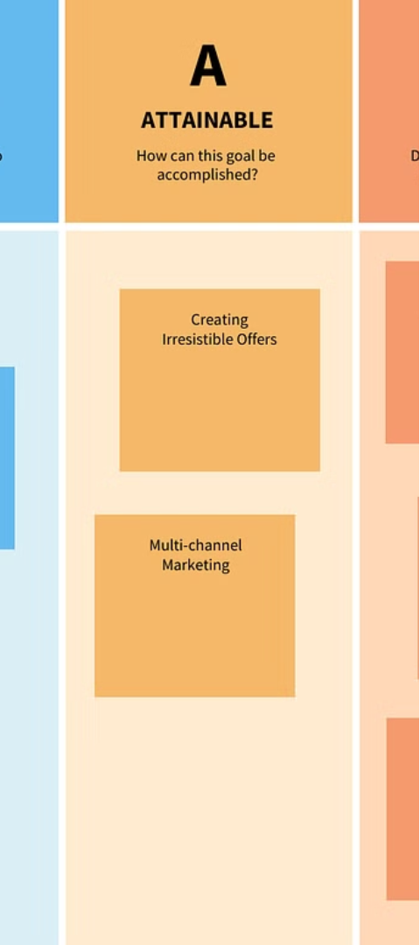
Objectives
1
Data Processing
2
Visualization
Efficiently transform raw sales data into meaningful monthly summaries.
Create insightful data visualizations to identify trends and patterns.
3
PDF Generation
Compile the analysis and visualizations into a professional-looking PDF report.

Slide 3
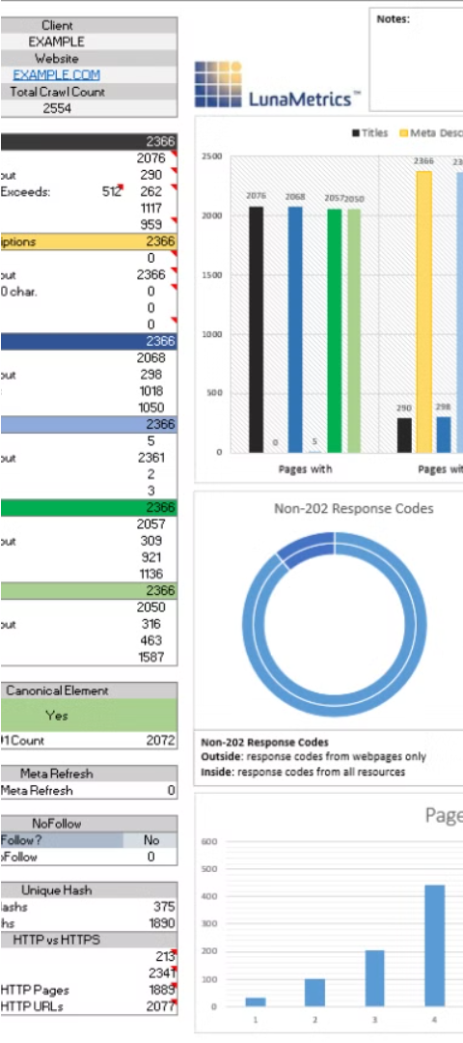
Data Processing
1
Data Import
Load the raw sales data into a Pandas DataFrame for manipulation.
2
Data Cleaning
Handle missing values, correct formatting, and ensure data integrity.
3
Monthly Summaries
Calculate key metrics like total sales, average order value, and customer count for each month.

Slide 4
Visualization
Sales Trends
Product Performance
Customer Insights
Line charts and bar graphs to display monthly sales performance.
Scatter plots and pie charts to analyze top-selling products.
Histograms and scatter plots to understand customer behavior.

Slide 5
PDF Generation
Report Structure
Customization
Shareable
Automatically compile the analysis, visualizations, and key findings into a professional PDF report.
Allows for the addition of a cover page, table of contents, and other user-defined elements.
The generated PDF can be easily shared with stakeholders and decision-makers.

Slide 6



Command-Line Interface
Input File
Configuration
Output Path
Specify the location of the raw sales data file.
Customize report settings such as company logo and report title.
Designate the destination for the generated PDF report.

Slide 7




Benefits
Time Savings
Automate the entire reporting process, reducing manual effort.
Informed Decisions
Gain deeper insights from comprehensive data analysis and visualization.
Professional Reporting
Deliver polished, visually appealing reports to stakeholders.

Slide 8
Major things
Sales Data Analysis
Purpose: Analyze sales data to compute monthly sales summaries for each product.
Functionality:
Load sales data from a text file.
Group and aggregate data to produce monthly sales summaries.
Data Visualization
Purpose: Visualize sales trends and performance over time.
Functionality:
Create bar charts showing monthly sales totals for each product.
Save the charts as image files for inclusion in reports and presentations.
Report Generation
Purpose: Generate a detailed PDF report that includes sales data and visualizations.
Functionality:
Create a PDF document with a structured sections.
Include a summary table of monthly sales data.
Embed sales charts into the PDF report.
Save the final PDF report to disk.
User Interaction
Purpose: Provide an easy-to-use interface for users to generate reports.
Functionality:
Display a menu to guide users in providing the path to the sales data file.
Validate user input and handle file-related errors gracefully.
Execute the complete report generation process based on user input.

Slide 9

Conclusion
This project revolutionizes the monthly sales reporting process, empowering businesses to streamline data analysis, generate insightful visualizations, and produce professional-grade PDF reports. By automating these critical tasks, organizations can make more informed decisions, improve operational efficiency, and enhance their overall sales strategy.

